Slide 1
Big Data and Data Analytics

Slide 2
CONTENTS
Module 1: Big Data
Module 2: Business Intelligence/Analytics
Module 3: Visualization
Module 4: Data Mining

Slide 3
What is Big Data?
MODULE 1

Slide 4
What is Big Data?
What is Big Data
Massive sets of unstructured/semi-structured data from Web traffic, social media, sensors, etc
Petabytes, exabytes of data
Volumes too great for typical DBMS
Information from multiple internal and external sources:
Transactions
Social media
Enterprise content
Sensors
Mobile devices
In the last minute there were …….
204 million emails sent
61,000 hours of music listened to on Pandora
20 million photo views
100,000 tweets
6 million views and 277,000 Facebook Logins
2+ million Google searches
3 million uploads on Flickr

Slide 5
What is Big Data? continued
Companies leverage data to adapt products and services to:
Meet customer needs
Optimize operations
Optimize infrastructure
Find new sources of revenue
Can reveal more patterns and anomalies
IBM estimates that by 2015 4.4 million jobs will be created globally to support big data
1.9 million of these jobs will be in the United States

Slide 6
Where does Big Data come from?
Email
Transactions
Enterprise “Dark Data”
Partner, Employee Customer, Supplier
Contracts
Monitoring
Public
Commercial
Sensor
Credit
Weather
Social Media
Industry
Population
Sentiment
Economic
Network

Slide 7
Types of Data

Slide 8
Types of Data
When collecting or gathering data we collect data from individuals cases on particular variables.
A variable is a unit of data collection whose value can vary.
Variables can be defined into types according to the level of mathematical scaling that can be carried out on the data.
There are four types of data or levels of measurement:
1. Categorical (Nominal) | 2. Ordinal
3. Interval | 4. Ratio
Notes:
When thinking about research we are looking at gathering knowledge through some form of observation.
Research in the scientific sense, as talked about in the first lecture, involves the systematic measurement of these observations.
When we observe something we understand that observation in terms of its attributes for example, colour or texture, and we look at how that attribute varies across our observations.
So, when we collect or gather data we collect information from individual cases (people, organisations, businesses and so on) about particular variables.
Level of mathematical scaling? The level of mathematical precision with which the values of a variable can be expressed.

Slide 9
Categorical (Nominal) data
Nominal or categorical data is data that comprises of categories that cannot be rank ordered – each category is just different.
The categories available cannot be placed in any order and no judgement can be made about the relative size or distance from one category to another.
Categories bear no quantitative relationship to one another
Examples:
- customer’s location (America, Europe, Asia)
- employee classification (manager, supervisor,
associate)
What does this mean? No mathematical operations can be performed on the data relative to each other.
Therefore, nominal data reflect qualitative differences rather than quantitative ones.

Slide 10
Nominal data
Examples:
What is your gender? (please tick)
Male
Female
Did you enjoy the film? (please tick)
Yes
No
Systems for measuring nominal data must ensure that each category is mutually exclusive and the system of measurement needs to be exhaustive.
Exhaustive: the system of categories system should have enough categories for all the observations
Variables that have only two responses i.e. Yes or No, are known as dichotomies.
Notes:
Mutually exclusive: each observation (person, case, score) cannot fall into more than one category.
Exhaustive: the system of categories system should have enough categories for all the observations.

Slide 11
Ordinal data
How satisfied are you with the level of service you have received? (please tick)
Very satisfied
Somewhat satisfied
Neutral
Somewhat dissatisfied
Very dissatisfied
Example:
Ordinal data is data that comprises of categories that can be rank ordered.
Similarly with nominal data the distance between each category cannot be calculated but the categories can be ranked above or below each other.
No fixed units of measurement
Examples:
- college football rankings
- survey responses
(poor, average, good, very good, excellent)
What does this mean? Can make statistical judgements and perform limited maths.
Notes:
Ordinal data works with the same assumptions as nominal data but is more complex in that here, whilst still comprising of categories, now the categories
themselves can be rank-ordered i.e. one category has more or less of some underlying quality than being in another category.
What does this mean? We can make statistical judgements about the relative position of one value to another and can perform limited mathematical calculations.

Slide 12
Interval and ratio data
Both interval and ratio data are examples of scale data.
Scale data:
data is in numeric format ($50, $100, $150)
data that can be measured on a continuous scale
the distance between each can be observed and as a result measured
the data can be placed in rank order.
Notes:
Ordinal data can be ranked – similarly interval and ratio data also operate on a mechanism of scale. The key difference is that with interval and ratio data the data is numerical and has numerically equal distances between each category. For example, a 5cm difference in height between 150cm and 155cm is the same as a 5cm difference between 15cm and 20cm.
Imagine a 30cm ruler – it shows equal distance between each mark i.e. 10 1mm markers between each cm.

Slide 13
Interval data
Ordinal data but with constant differences between observations
Ratios are not meaningful
Examples:
Time – moves along a continuous measure or seconds, minutes and so on and is without a zero point of time.
Temperature – moves along a continuous measure of degrees and is without a true zero.
SAT scores
Notes:
Temperature and true zero – whilst there is a zero degrees this is a measure of temperature!

Slide 14
Ratio data
Ratio data measured on a continuous scale and does have a natural zero point.
Ratios are meaningful
Examples:
monthly sales
delivery times
Weight
Height
Age

Slide 15
Data for Business Analytics
(continued)
Classifying Data Elements in a Purchasing Database
Figure 1.2
Ratio
Ratio
Ratio
Ratio
Interval
Interval
Categorical
Categorical
Categorical
Categorical
If there was field (column) for Supplier Rating (Excellent, Good, Acceptable, Bad), that data would be classified as Ordinal

Slide 16
Big Data Characteristics
Growing quantity of data
e.g. social media, behavioral, video
VOLUME
VARIETY
Quickening speed of data
e.g. smart meters, process monitoring
VELOCITY
Gartner, Feb 2001
Increase in types of data
e.g. app data, unstructured data

Slide 17
Which Big Data characteristic is the biggest issue for your organization?
Source: Getting Value from Big Data, Gartner Webinar, May 2012

Slide 18
Volume
Volume
Petabytes, exabytes of data
Volumes too great for typical DBMS

Slide 19
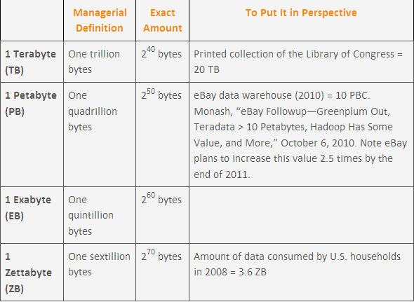
Volume - Bytes Defined
eBay data warehouse (2010) = 10 PB
eBay will increase this 2.5 times by 2011
Teradata > 10 PB
Megabyte: 2²⁰ bytes or, loosely, one million bytes
Gigabyte: 2³⁰ bytes or, loosely one billion bytes

Slide 20
Velocity
Velocity
Massive amount of streaming data

Slide 21
Variety
Variety
Massive sets of unstructured/semi-structured data from Web traffic, social media, sensors, and so on

Slide 22
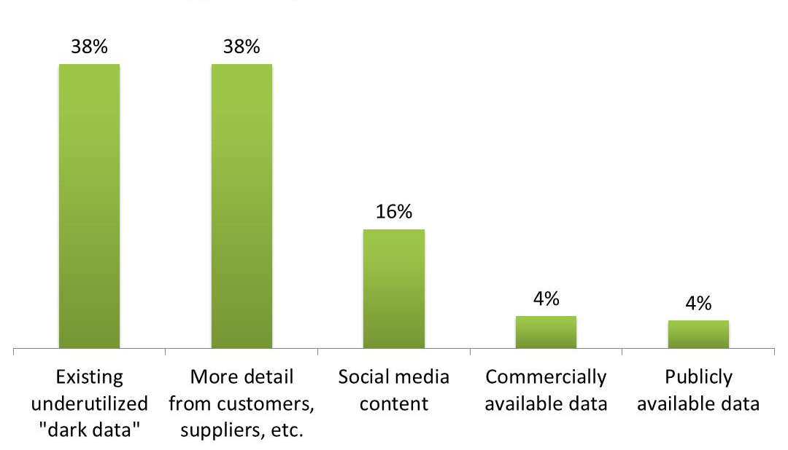
Which source of data represents the most immediate opportunity?
Source: Getting Value from Big Data, Gartner Webinar, May 2012

Slide 23
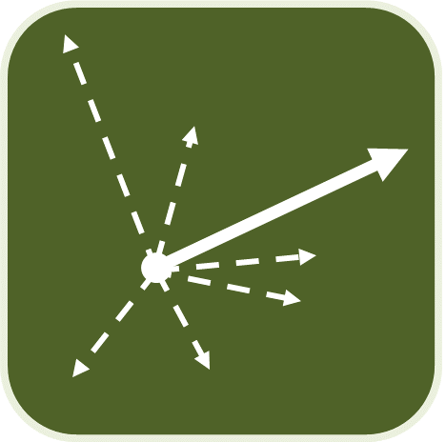
Big Data Opportunities
Making better informed decisions
e.g. strategies, recommendations
Discovering hidden insights
e.g. anomalies forensics, patterns, trends
Automating business processes
e.g. complex events, translation

Slide 24
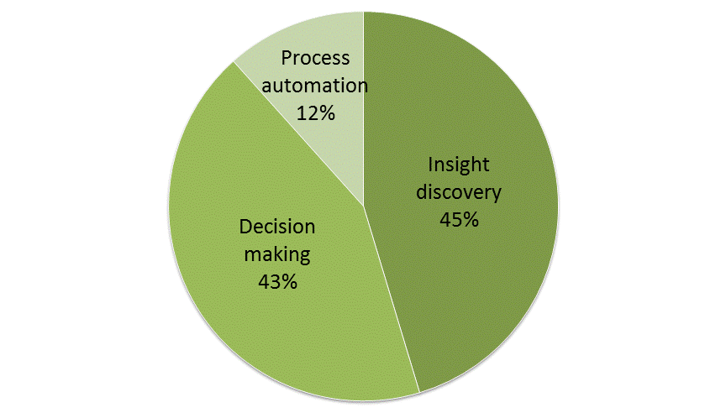
Which is the biggest opportunity for Big Data in your organization?
Through 2017:
85% of Fortune 500 organizations will be unable to exploit big data for competitive advantage.
Business analytics needs will drive 70% of investments in the expansion and modernization of information infrastructure.
Source: Getting Value from Big Data, Gartner Webinar, May 2012

Slide 25
Identifying Insurance Fraud
Auto Insurance
Opportunity
Save and make money by reducing fraudulent auto insurance claims
Data & Analytics
Predictive analytics against years of historical claims and coverage data
Text mining adjuster reports for hidden clues, e.g. missing facts, inconsistencies, changed stories
Results
Improved success rate in pursuing fraudulent claims from 50% to 88%; reduced fraudulent claim investigation time by 95%
Marketing to individuals with low propensity for fraud
What **“dark data” is just laying around that can transform business processes?
**Operational data that is not being used. Consulting and market research company Gartner Inc. describes dark data as "information assets that organizations collect, process and store in the course of their regular business activity, but generally fail to use for other purposes."

Slide 26
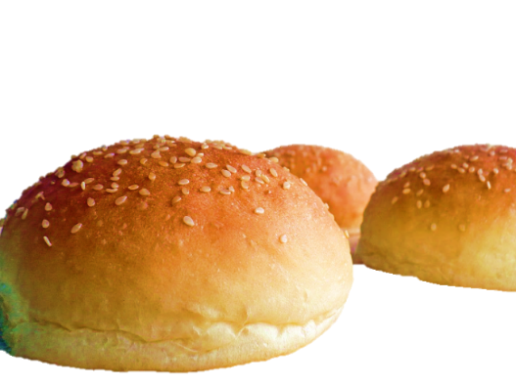
Quality Improvement
Opportunity
Move from manual to automated inspection of burger bun production to ensure and improve quality
Data & Analytics
Photo-analyze over 1000 buns-per-minute for color, shape and seed distribution
Continually adjust ovens and process automatically
Result
Eliminate 1000s of pounds of wasted product per year; speed production; save energy; Reduce manual labor costs
Is the company using all of its “senses” to observe, measure and optimize business processes?

Slide 27
Improving Corporate Image
Opportunity
Improve reputation, brand and buzz by tapping social media
Data & Analytics
Continually scanning twitterverse for mentions of their business
Integrating tweeters with their robust customer management system
Results
Saw tweet from a top customer lamenting late flight—no time to dine at Morton’s
Tuxedo-clad waiter waiting for him when he landed with a bag containing his favorite steak, prepared the way he normally likes it with all the fixin’s
How can the company listen, analyze and respond in real-time?

Slide 28
Big Data, Big Rewards
Read the case study “Big Data, Big Rewards”

Slide 29
Business Analytics
MODULE 2

Slide 30
Business Analytics/Business Intelligence
Business Analytics/Business intelligence (BI) is a broad category of applications, technologies, and processes for:
gathering,
storing,
accessing, and
analyzing data
to help business users make better decisions.

Slide 31
Things Are Getting More Complex
Many companies are performing new kinds of analytics (**sentiment analysis, etc.), to better and more quickly understand and respond to what customers are saying about them and their products.
The cloud, and appliances are being used as data stores
Advanced analytics are growing in popularity and importance
**Sentiment analysis (also known as opinion mining) refers to the use of natural language processing, text analysis and computational linguistics to identify and extract subjective information in source materials.

Slide 32
Uncertainty of Data

Slide 33
Analytics Models
How can we make it happen?
Prescriptive Analytics
What will happen?
Predictive Analytics
Why did it happen?
Optimization
VALUE
Diagnostic
Analytics
What happened?
Descriptive Analytics
Hindsight Insight Foresight
Information
DIFFICULTY

Slide 34
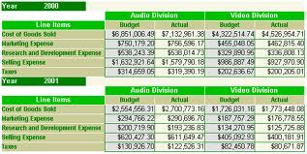
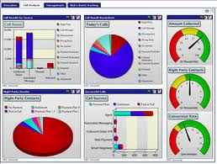
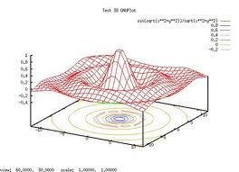
Descriptive Analytics
Descriptive analytics, such as reporting/OLAP, dashboards, and data visualization, have been widely used for some time.
They are the core of traditional BI.
What has occurred?
Descriptive analytics, such as data visualization, is important in helping users interpret the output from predictive and predictive analytics.
Notes:
Descriptive analytics, such as reporting/OLAP, dashboards, and data visualization, have been widely used for some time. They are the core of traditional BI.

Slide 35
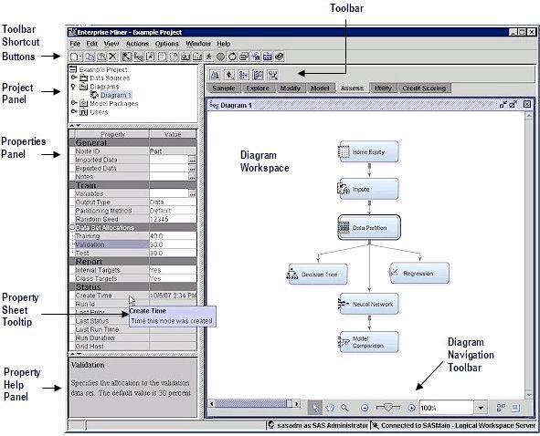
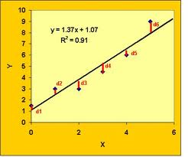
Predictive Analytics
Algorithms for predictive analytics, such as regression analysis, machine learning, and neural networks, have also been around for some time.
What will occur?
Marketing is the target for many predictive analytics applications.
Descriptive analytics, such as data visualization, is important in helping users interpret the output from predictive and prescriptive analytics.
Notes:
Algorithms for predictive analytics, such as regression analysis, machine learning, and neural networks, have also been around for some time. Recently, however, software products have made them much easier to understand and use. They have also been integrated into specific applications, such as for campaign management. Marketing is the target for many predictive analytics applications. Descriptive analytics, such as data visualization, is important in helping users interpret the output from predictive and predictive analytics. Prescriptive analytics are often referred to as advanced analytics.

Slide 36
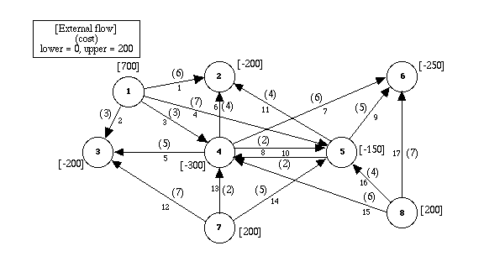
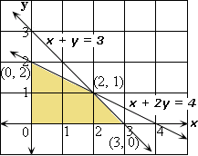
Prescriptive Analytics
Prescriptive analytics are often referred to as advanced analytics.
Often for the allocation of scarce resources
Optimization
What should occur?
Prescriptive analytics can benefit healthcare strategic planning by using analytics to leverage operational and usage data combined with data of external factors such as economic data, population demographic trends and population health trends, to more accurately plan for future capital investments such as new facilities and equipment utilization as well as understand the trade-offs between adding additional beds and expanding an existing facility versus building a new one.
Notes:
Prescriptive analytics provide an optimal solution, often for the allocation of scarce resources. They, too, have been in academia for a long time but are now finding wider use in practice. For example, the use of mathematical programming for revenue management is common for organizations that have “perishable” goods (e.g., rental cars, hotel rooms, airline seats). Harrah’s has been using revenue management for hotel room pricing for some time.

Slide 37
Organizational Transformation
Analytics are a competitive requirement
For BI-based organizations, the use of BI/analytics is a requirement for successfully competing in the marketplace.
TDWI report on Big Data Analytics found that 85% of respondents indicated that their firms would be using advanced analytics within three years
IBM/MIT Sloan Management Review research study found that top performing companies in their industry are much more likely to use analytics rather than intuition across the widest range of possible decisions.
Notes:
In some industries, the use of advanced analytics has moved beyond a “nice to have” to being a requirement.

Slide 38
Complex Systems Require Analytics
Tackle complex problems and provide individualized solutions
Products and services are organized around the needs of individual customers
Dollar value of interactions with each customer is high
There is high level of interaction with each customer
Examples: IBM, World Bank, Halliburton

Slide 39
Volume Operations Require Analytics
Serves high-volume markets through standardized products and services
Each customer interaction has a low dollar value
Customer interactions are generally conducted through technology rather than person-to-person
Are likely to be analytics-based
Examples: Amazon.com, eBay, Hertz
Notes:
Analytics are critical to high volume companies competing in the marketplace.

Slide 40
The Nature of the Industry
Online retailers like Amazon.com and Overstock.com are high volume operations who rely on analytics to compete.
When you enter their sites a cookie is placed on your PC and all clicks are recorded.
Based on your clicks and any search terms, recommendation engines decide what products to display.
After you purchase an item, they have additional information that is used in marketing campaigns.
Customer segmentation analysis is used in deciding what promotions to send you.
How profitable you are influences how the customer care center treats you.
A pricing team helps set prices and decides what prices are needed to clear out merchandise.
Forecasting models are used to decide how many items to order for inventory.
Dashboards monitor all aspects of organizational performance
Notes:
Online retailers like Amazon.com and Overstock.com are great examples of high volume operations who rely on analytics to compete. As soon as you enter, their sites a cookie is placed on your PC and all clicks are recorded. Based on your clicks and any search terms, recommendation engines decide what products to display. After you purchase an item, they have additional information that is used in marketing campaigns. Customer segmentation analysis is used in deciding what promotions to send you. How profitable you are influences how the customer care center treats you. A pricing team helps set prices and decides what prices are needed to clear out merchandise. Forecasting models are used to decide how many items to order for inventory. Dashboards monitor all aspects of organizational performance.

Slide 41
Knowledge Requirements for Advanced Analytics
Business Domain
Data
Modeling
Choosing the right data to include in models is important.
Important to have some thoughts as to what variables might be related.
Domain knowledge is necessary to understand how they can be used. Role of Business Analyst is crucial
Consider the story of the relationship between beer and diapers in the market basket of young males in convenience stores.
You still have to decide (or experiment to discover) whether it is better to put them together or spread them across the store (in the hope that other things will be bought while walking the isles).
The findings were that men between 30- 40 years in age, shopping between 5pm and 7pm on Fridays, who purchased diapers were most likely to also have beer in their carts. This motivated the grocery store to move the beer isle closer to the diaper isle and instantaneously, a 35% increase in sales of both!

Slide 42
Visualization
MODULE 3

Slide 43
Visualization: Acquisition of Insight
Many people and institutions possess data that may ‘hide’ fundamental relations
Realtors
Bankers
Air Traffic Controller
Fraud investigators
Engineers
They want to be able to view some graphical representation of that data, maybe interact with it, and then be able to say…….ahha!
. . . . . .

Slide 44
Example: Fraud Detection
The Serious Fraud Office (SFO) suspected mortgage fraud
The SFO provided 12 filing cabinets of data
After 12 person years a suspect was identified
The suspect was arrested, tried and convicted

Slide 45
Example: Fraud Detection continued
The data was supplied in electronic form
A visualization tool (Netmap) was used to examine the data
After 4 person weeks the same suspect was identified
A master criminal behind the fraud was also identified

Slide 46
Is Information Visualization Useful?
Drugs and Chips
Texas Instruments
Manufactures microprocessors on silicon wafers that are routed through 400 steps in many weeks. This process is monitored, gathering 140,000 pieces of information about each wafer. Somewhere in that heap of data can be warnings about things going wrong. Detect a bug early before bad chips are made. TI uses visualization tools to make the detection process easier
Eli Lilly
Has 1500 scientists using an advanced information visualization tool (Spotfire) for decision making. “With its ability to represent multiple sources of information and interactively change your view, it’s helpful for homing in on specific molecules and deciding whether we should be doing further testing on them”
Sheldon Ort of Eli Lilly, speaking to Fortune

Slide 47
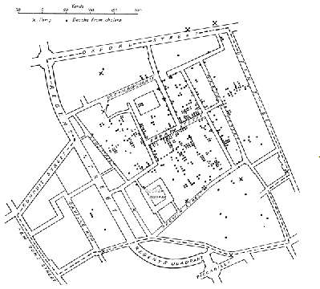
The Cholera Epidemic, London 1845
Dr. John Snow, medical officer for London, investigated the cholera epidemic of 1845 in Soho. He mapped the deaths and noted that the deaths, indicated by points, tended to occur near the Broad Street pump. Closure of the pump coincided with a reduction in cholera.

Slide 48
Challenger Disaster
On 28th January 1986 the space shuttle Challenger exploded, and seven astronauts died, because two rubber O-Rings leaked.
The previous day, engineers who designed the rocket opposed the launch, concerned that the O-Rings would not seal at the forecast temperature (25 to 29oF).
After much discussion, the decision was taken to go ahead.
Cause of the accident:
An inability to assess the link between cool temperature and O-Ring damage on earlier flights.
Many charts poorly presented

Slide 49
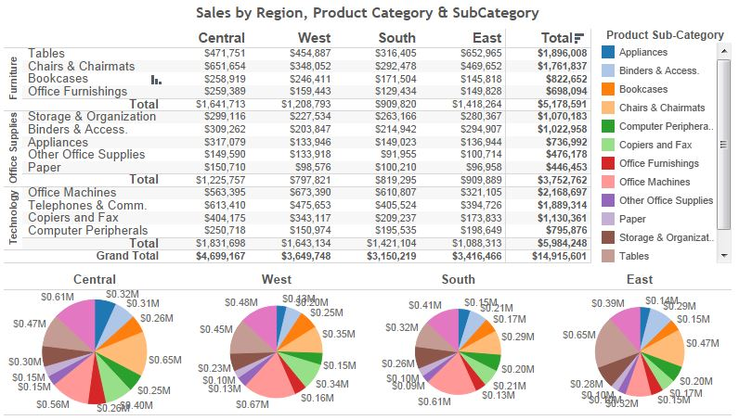
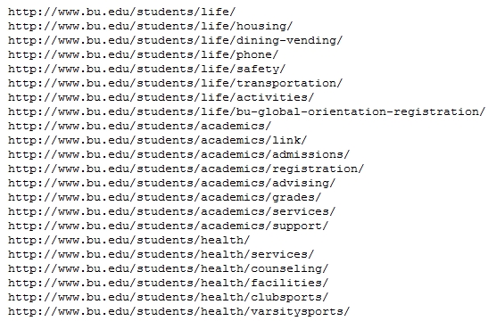
Visualization
Refers to the innovative use of images and interactive technology to explore large, high- density datasets
Help users see patterns and relationships that would be difficult to see in text lists
Rich graphs, charts
Dashboards
Maps
Increasingly is being used to identify insights into both structured and unstructured data for such areas as
operational efficiencies
profitability
strategic planning
Video Tableau

Slide 50
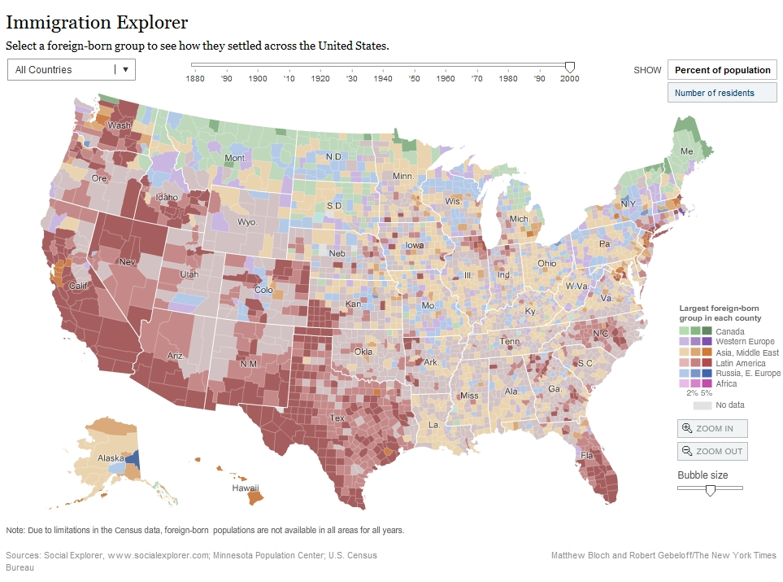
Examples
Geo data
mapping
Demo
Introduction to Information Visualization - Fall 2012
Notes:
50

Slide 51
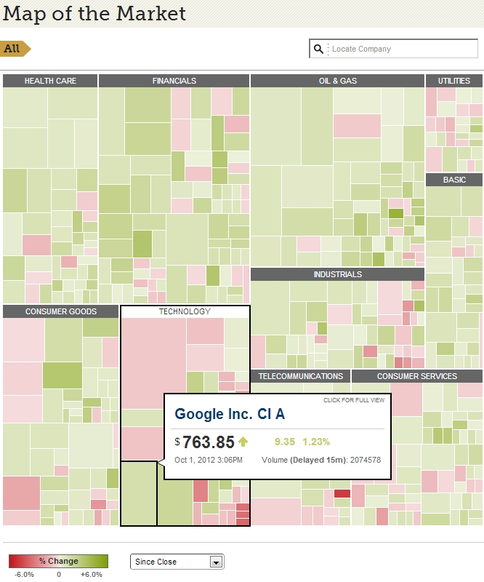
Examples
Treemap
Demo
Introduction to Information Visualization - Fall 2012
Notes:
51

Slide 52
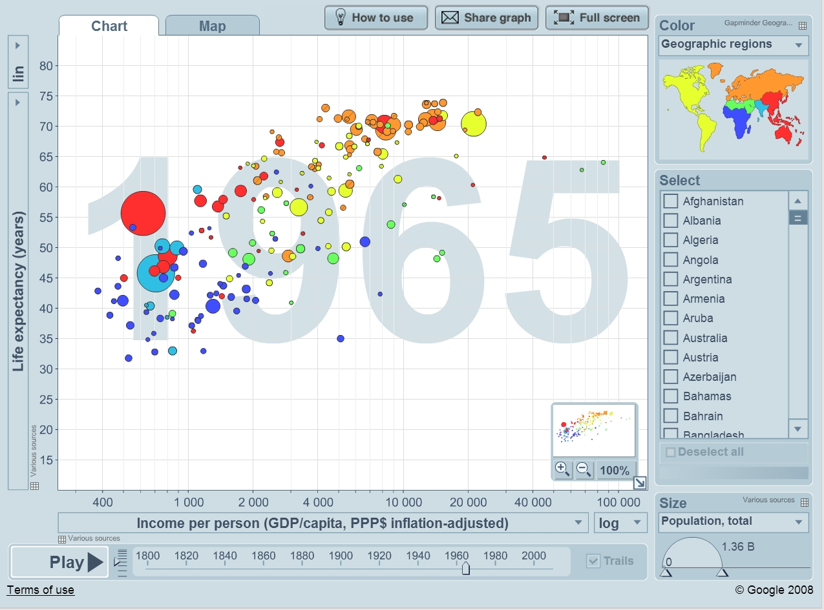
Examples
Population
“Trendalyzer”
Demo
Introduction to Information Visualization - Fall 2012
Notes:
52

Slide 53
Video on the use of visualization to extract knowledge from data.
Watch Gary Flake on extreme visualization

Slide 54
Data Mining
MODULE 4

Slide 55
What is Data Mining?
The process of semi automatically analyzing large databases to find useful patterns (Silberschatz)
Areas of Use
Sales/ Marketing
Diversify target market
Identify clients needs to increase response rates
Risk Assessment
Identify Customers that pose high credit risk
Fraud Detection
Identify people misusing the system. E.g. People who have two Social Security Numbers
Credit Card Fraud Detection
Detect significant deviations from normal behavior:
Network Intrusion Detection
Customer Care
Identify customers likely to change providers
Identify customer needs
Medicine
Match patients with similar problems → cure

Slide 56
Data Mining Techniques...
Classification [Predictive]
Clustering [Descriptive]
Association Rule Discovery [Descriptive]
Sequential Pattern Discovery [Descriptive]
Regression [Predictive]
Deviation Detection [Predictive]

Slide 57
Classification
Classification is the process of predicting the class of a new item.
Categorize the new item and identify to which class it belongs
Example: A bank wants to classify its Home Loan Customers into groups according to their response to bank advertisements. The bank might use the classifications “Responds Rarely, Responds Sometimes, Responds Frequently”.
The bank will then attempt to find rules about the customers that respond Frequently and Sometimes.
The rules could be used to predict needs of potential customers.

Slide 58
Technique for Classification
Decision-Tree Classifiers
Job
Job
Engineer
Doctor
Carpenter
Income
Income
Income
>100K
<30K
>50K
<40K
>90K
<50K
Bad
Good
Bad
Good
Bad
Good
Predicting credit risk of a person with the jobs specified.

Slide 59
Classification: Application 1
Direct Marketing
Goal: Reduce cost of mailing by targeting a set of consumers likely to buy a new cell-phone product.
Approach:
Use the data for a similar product introduced before.
We know which customers decided to buy and which decided otherwise. This {buy, don’t buy} decision forms the class attribute.
Collect various demographic, lifestyle, and company-interaction related information about all such customers.
Type of business, where they stay, how much they earn, etc.
Use this information as input attributes to learn a classifier model.

Slide 60
Classification: Application 2
Fraud Detection
Goal: Predict fraudulent cases in credit card transactions.
Approach:
Use credit card transactions and the information on its account-holder as attributes.
When does a customer buy, what does he buy, how often he pays on time, etc.
Label past transactions as fraud or fair transactions. This forms the class attribute.
Learn a model for the class of the transactions.
Use this model to detect fraud by observing credit card transactions on an account.

Slide 61
Classification: Application 3
Customer Attrition/Churn:
Goal: To predict whether a customer is likely to be lost to a competitor.
Approach:
Use detailed record of transactions with each of the past and present customers, to find attributes.
How often the customer calls, where he calls, what time-of-the day he calls most, his financial status, marital status, etc.
Label the customers as loyal or disloyal.
Find a model for loyalty.

Slide 62
Clustering
Clustering algorithms find groups of items that are similar. … It divides a data set so that records with similar content are in the same group, and groups are as different as possible from each other.
Example: Insurance company could use clustering to group clients by their age, location and types of insurance purchased.
The categories are unspecified and this is referred to as ‘unsupervised learning’

Slide 63
Clustering continued
Group data into clusters
Similar data is grouped in the same cluster
Dissimilar data is grouped in the a different cluster
How is this achieved ?
Hierarchical
Group data into t-trees
K-Nearest Neighbor
A classification method that classifies a point by calculating the distances between the point and points in the training data set. Then it assigns the point to the class that is most common among its k-nearest neighbors (where k is an integer)

Slide 64
Clustering: Application 1
Document Clustering:
Goal: To find groups of documents that are similar to each other based on the important terms appearing in them.
Approach: To identify frequently occurring terms in each document. Form a similarity measure based on the frequencies of different terms. Use it to cluster.
Gain: Information Retrieval can utilize the clusters to relate a new document or search term to clustered documents.

Slide 65
Clustering: Application 2
Market Segmentation:
Goal: subdivide a market into distinct subsets of customers where any subset may conceivably be selected as a market target to be reached with a distinct marketing mix.
Approach:
Collect different attributes of customers based on their geographical and lifestyle related information.
Find clusters of similar customers.
Measure the clustering quality by observing buying patterns of customers in same cluster vs. those from different clusters.

Slide 66
Association Rule: Definition
Given a set of records each of which contain some number of items from a given collection;
Produce dependency rules which will predict occurrence of an item based on occurrences of other items.
Example: When a customer buys a hammer, then 90% of the time they will buy nails.
Rules Discovered:
{Milk} --> {Coke}
{Diaper, Milk} --> {Beer}

Slide 67
Association Rule Discovery: Application 1
Marketing and Sales Promotion:
Let the rule discovered be
{Bagels, … } --> {Potato Chips}
Potato Chips as consequent => Can be used to determine what should be done to boost its sales.
Bagels in the antecedent => Can be used to see which products would be affected if the store discontinues selling bagels.
Bagels in antecedent and Potato chips in consequent => Can be used to see what products should be sold with Bagels to promote sale of Potato chips!

Slide 68
Association Rule Discovery: Application 2
Supermarket shelf management.
Goal: To identify items that are bought together by sufficiently many customers.
Approach: Process the point-of-sale data collected with barcode scanners to find dependencies among items.
A classic rule --
If a customer buys diaper and milk, then he is very likely to buy beer.
So, don’t be surprised if you find six-packs stacked next to diapers!

Slide 69
Association Rule Discovery: Application 3
Inventory Management:
Goal: A consumer appliance repair company wants to anticipate the nature of repairs on its consumer products and keep the service vehicles equipped with right parts to reduce on number of visits to consumer households.
Approach: Process the data on tools and parts required in previous repairs at different consumer locations and discover the co-occurrence patterns.

Slide 70
Sequential Pattern Discovery
Given is a set of objects, with each object associated with its own timeline of events, find rules that predict strong sequential dependencies among different events.
Rules are formed by first discovering patterns. Event occurrences in the patterns are governed by timing constraints.
In telecommunications alarm logs,
(Inverter_Problem Excessive_Line_Current)
(Rectifier_Alarm) --> (Fire_Alarm)
In point-of-sale transaction sequences,
Computer Bookstore:
(Intro_To_Visual_C) (C++_Primer) --> (Perl_for_dummies,Tcl_Tk)
Athletic Apparel Store:
(Shoes) (Racket, Racketball) --> (Sports_Jacket)

Slide 71
Regression
Predict a value of a given continuous valued variable based on the values of other variables, assuming a linear or nonlinear model of dependency.
Greatly studied in statistics, neural network fields.
Examples:
Predicting sales amounts of new product based on advertising expenditure.
Predicting wind velocities as a function of temperature, humidity, air pressure, etc.
Time series prediction of stock market indices.

Slide 72
Using Databases to Improve Business Performance and Decision Making
Web mining
Discovery and analysis of useful patterns and information from Web
Understand customer behavior
Evaluate effectiveness of Web site, and so on
Web content mining
Mines content of Web pages
Web structure mining
Analyzes links to and from Web page
Web usage mining
Mines user interaction data recorded by Web server
Notes:
This slide continues the exploration of mining stored data for valuable information. In addition to text mining, there are several ways to mine information on the Web. The text uses the example of marketers using Google Trends and Google Insights for Search services, which track the popularity of various words and phrases used in Google search queries, to learn what people are interested in and what they are interested in buying. What type of Web mining is this? Why might a marketer be interested in the number of Web pages that link to a site?

Slide 73
Using Databases to Improve Business Performance and Decision Making
Text mining
Extracts key elements from large unstructured data sets
Stored e-mails
Call center transcripts
Legal cases
Patent descriptions
Service reports, and so on
Sentiment analysis software
Mines e-mails, blogs, social media to detect opinions
Notes:
Whereas data mining describes analysis of data in databases, there are other types of information that can be “mined,” such as text mining and Web mining.

Slide 74
Big Data, Big Rewards
Read the case study “Big Data, Big Rewards”

